Slide 1


Baseball III
Produced by Dr. Mario | UNC STOR 538

Slide 2

Linear Weights
S = Single
D = Double
T = Triple
HR = Home Run
BB = Walk
HBP = Hit-by-Pitch
SB = Stolen Base
CS = Caught
Stealing
Multiple Linear Regression
Baseball Application
$Y=Runs for the Season$
$\vec{X}={\left[BB+HBP,S,D,T,HR,SB,CS\right]}^{′}$
$Y={\vec{X}}^{′}\vec{β}+\vec{ε}$
$\hat{Y}=Predicted Runs$
$\hat{Y}={\vec{X}}^{′}\hat{\vec{β}}$
$$Y=β_{0}+β_{1}X_{1}+…+β_{k}X_{k}+ϵ$$
Linear Weights

Slide 3

Linear Weights
Estimated Linear Weights Using Least Squares
Predictor | Estimate
Constant | -411.81
Single | 0.46
Double | 0.81
Triple | 1.07
HR | 1.43
BB+HBP | 0.33
SB | 0.25
CS | -0.25
$$n=210$$
$$R^{2}=0.90$$
$$Adj. R^{2}=0.90$$
Used to Be Insignificant
Doesn’t Add Marginal Value

Slide 4
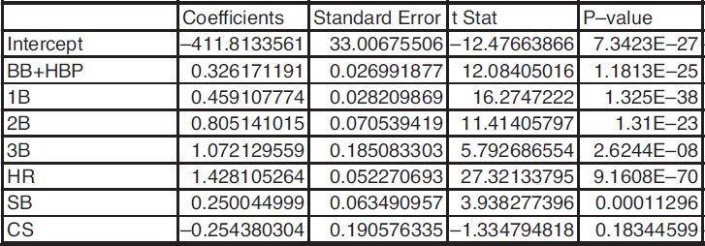
Linear Weights
Important Information From Linear Regression

Slide 5
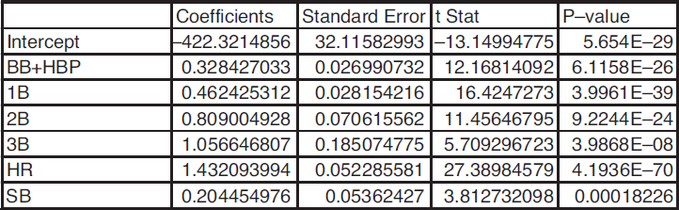

Linear Weights
Important Information From Linear Regression
Removal of Insignificant Variables
$MAD=17.15$ (Now) vs. $MAD=26$ (Bill James)

Slide 6
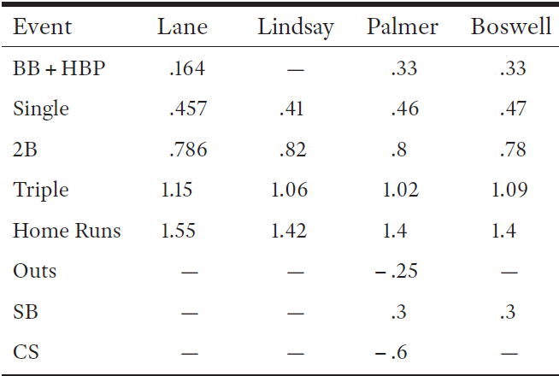
Linear Weights
Historical Progression
1916
1950-1960
1978
1989
Now
0.33
0.46
0.81
1.06
1.43
-
0.20
-

Slide 7


Linear Weights
Evaluation of Hitters
Imagine if Team Had Only Mike Trout (2016)
Approximately,
Trout Hit 29 HR and Had 366.118 Outs
Therefore, Trout Hit
Scaling Up, We Expect a Team of Trouts to Hit on Average
Using Linear Weights, We Expect 1,588.07 Runs Per Season which Can Be Thought of 9.80 Runs Per Game
$$26.72×162=4329 Outs Per Season$$
$$\frac{29}{366.118}=0.079 Home Runs Per Out$$
$$4329×\frac{29}{366.118}=342.9 Home Runs Per Season$$

Slide 8

Linear Weights
OBP, SLG, OPS, and Runs Created
Moneyball Highlights the Importance of OBP
From 2010-2016, Average OBP was 32%
Purpose of OPS = Value Power Hitters
Recall:
Which Covariate (OBP or SLG) is Better for Predicting Runs?
$$OPS=OBP+SLG$$
$=1×OBP+1×SLG$
Equal Weights

Slide 9


Linear Weights
OBP, SLG, OPS, and Runs Created
Multiple Regression (2010-2016 Team Data)
Summary: OBP is More Important Than SLG (1.4 Times More)
$$Runs=β_{0}+β_{1}(SLG)+β_{2}(OBP)+ϵ$$
$n=210$ & $R^{2}=0.89 \& Adj. R^{2}=0.88$

Slide 10
Linear Weights
Runs Created Above Average
How Many More Runs if Average Team Added a Player?
Average Team (2010-2016) Versus Bryant (2016)
Hit Type | Average Team | Bryant 2016
Single | 939.83 | 99
Double | 276.2 | 35
Triple | 29.16 | 3
HR | 159.36 | 39
BB+HBP | 544.59 | 93
SB | 95.08 | 8
Outs | 4328.64 | 416.15

Slide 11
Linear Weights
Runs Created Above Average
Hit Type | Average Team | Bryant | Bryant + Team
Single | 939.83 | 99 | 948.48
Double | 276.2 | 35 | 284.64
Triple | 29.16 | 3 | 29.36
HR | 159.36 | 39 | 183.04
BB+HBP | 544.59 | 93 | 597.33
SB | 95.08 | 8 | 93.94

Slide 12

Linear Weights
Runs Created Above Average
If Added, Rest of Players Will Cost an Approximate
For the Rest of The Team, This is Equivalent to
Singles With Bryant Added to Roster
$$4328.64−416.15=3912.49 Outs$$
$$\frac{3912.49}{4328.64}=90.4\% of Total Outs$$
$$Singles=0.904\left(Singles of Team\right)+\left(Singles of Bryant\right)$$
$$=0.904\left(939.83\right)+\left(99\right)=948.61$$

Slide 13
Linear Weights
Runs Created Above Average
Predicted Runs of Average Team = 693.02
Predicted Runs of Bryant+Average Team = 751.08
Added Value of Bryant = 751.08-693.02 = 58 Runs Above Average

Slide 14

Final Inspiration
If you don’t like sports,
you may like baseball.
- Mahatma Mario

